Slide 1
PRAM 1 Model and basic algorithms
CS121 Parallel Computing
Spring 2018

Slide 2
PRAM
CPU
CPU
. . . .
memory
CPU
Parallel Random Access Machine, generalizes von Neumann model for sequential computing.
Given input of size n, we have f(n) processors accessing a shared memory.
f(n) can be very large, even larger than n.
All processors execute in synchronized steps.
In each step, each processor reads a memory location, computes, then writes a memory location.
CPU

Slide 3
PRAM
Theoretically interesting model, but not practical.
Assumes unrealistically large number of processors.
Also assumes all processors can communicate every time step; ignores memory latency and bandwidth.
PRAM’s main use is as a simple, clean model to develop parallel algorithms.
First maximize parallelism inherent in problem using PRAM.
Then simulate the algorithm with real hardware, i.e. map it onto hardware with limited processors / communication.
Ex Some GPU algorithms are adaptations of PRAM algorithms.

Slide 4
Memory conflicts
What if processors read / write to the same memory location in same time step?
EREW Exclusive read exclusive write.
Most restrictive model. Algorithm returns error if processors read/write same location simultaneously.
CREW Concurrent read exclusive write.
Several processors can read same location simultaneously, but error if they write.
ERCW Exclusive read concurrent write.
Uncommon.
CRCW Concurrent read concurrent write.
If multiple writes to same location, can either
Let an arbitrary write succeed.
Choose a write according to some priority to succeed.

Slide 5
Work and depth
Depth is the number of (parallel) steps till a PRAM algorithm terminates.
Polylogarithmic depth means the algorithm terminates in O(log(n)^{k}) steps, where n is input size and k is constant.
Goal for PRAM algorithms is often polylog depth using O(n^{k}) number of processors.
Work is (number of processors used) x depth.
Work of sequential algorithm is just its depth, i.e. time complexity.
Work of parallel algorithm ≥ O(work of best sequential algorithm).
If the work is equal, the parallel algorithm is work-efficient.
In practice, minimizing work of PRAM algorithm is more important than minimizing depth.

Slide 6
Parallel carry lookahead addition
a
1 0 1 1 0 0 1
+ 1 0 1 0 0 1 1
1 0 1 0 0 1 1
1 0 1 0 1 1 0 0
b
carry
sum
Suppose we want to add two n-digit binary numbers, but we can only add a single digit at a time and compute its carry.
This is what’s provided by full adders in a CPU.
If we add digit by digit using the grade school method, it takes O(n) time.
For n=32 or n=64, this is much too slow.
Each digit in the sum depends on the digit from the summands, but also a carry bit from the previous digit.
The summand digits can be added in parallel, but it seems the carry bits must be computed sequentially.
a_{i} | b_{i} | c_{i} | s_{i} | c_{i+1}
0 | 0 | 0 | 0 | 0
0 | 0 | 1 | 1 | 0
0 | 1 | 0 | 1 | 0
0 | 1 | 1 | 0 | 1
1 | 0 | 0 | 1 | 0
1 | 0 | 1 | 0 | 1
1 | 1 | 0 | 0 | 1
1 | 1 | 1 | 1 | 1

Slide 7
Parallel carry lookahead addition
We’ll show how to compute all the carry bits in parallel in O(log n) time using n processors.
After this, all the sum bits can be computed in O(1) parallel time, since s_{i} = a_{i}⊕b_{i}⊕c_{i}.
Denote bitwise AND and OR by ⋅ and +.
Define g_{i} = a_{i}b_{i} as i’th “carry generate” bit.
If a_{i}=b_{i}=1, c_{i+1}=1 no matter what c_{i} is.
Define p_{i} = a_{i}⊕b_{i} as i’th “carry propagate” bit.
If p_{i}=1, then c_{i+1}=c_{i}.

Slide 8
Parallel carry lookahead addition
We have c_{i+1} = g_{i}+c_{i}p_{i}.
Carry the i+1’st bit if
i’th bit of a and b generate a carry, OR
We carried the i’th bit, and this was propagated by a and b’s i’th bit.
We can also verify c_{i+1} = g_{i}+c_{i}p_{i} directly.
a_{i} | b_{i} | c_{i} | g_{i} | p_{i} | c_{i+1}
0 | 0 | 0 | 0 | 0 | 0
0 | 0 | 1 | 0 | 0 | 0
0 | 1 | 0 | 0 | 1 | 0
0 | 1 | 1 | 0 | 1 | 1
1 | 0 | 0 | 0 | 1 | 0
1 | 0 | 1 | 0 | 1 | 1
1 | 1 | 0 | 1 | 0 | 1
1 | 1 | 1 | 1 | 0 | 1

Slide 9
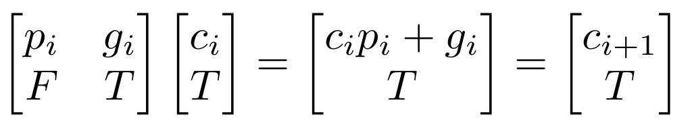
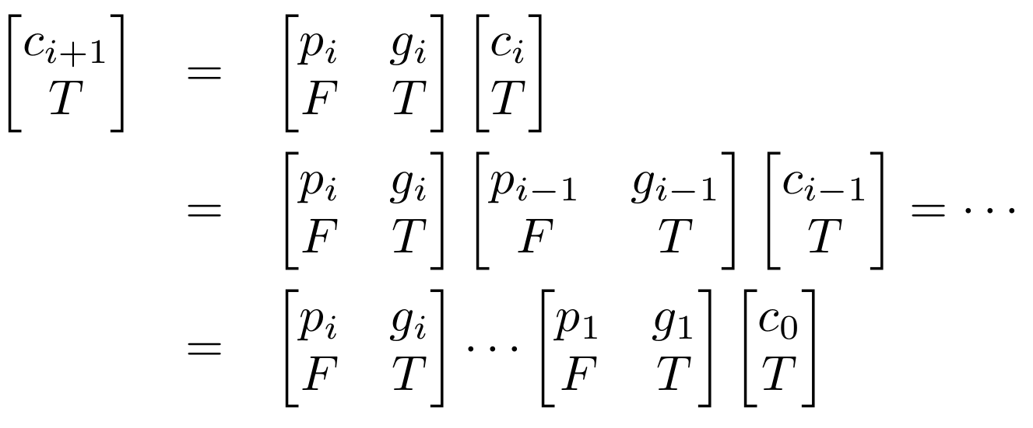
Parallel carry lookahead addition
Observation Can write
Recall ⋅ and + represent AND and OR.
Boolean matrix multiplication done same way as for reals.
Applying this repeatedly, we get
Since all the p_{i} and g_{i} values are known, the final product can be computed using prefix sum in O(log n) time with n processors.
This algorithm or variants are implemented in most real CPUs.

Slide 10
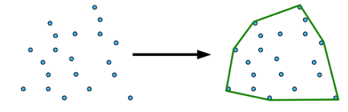
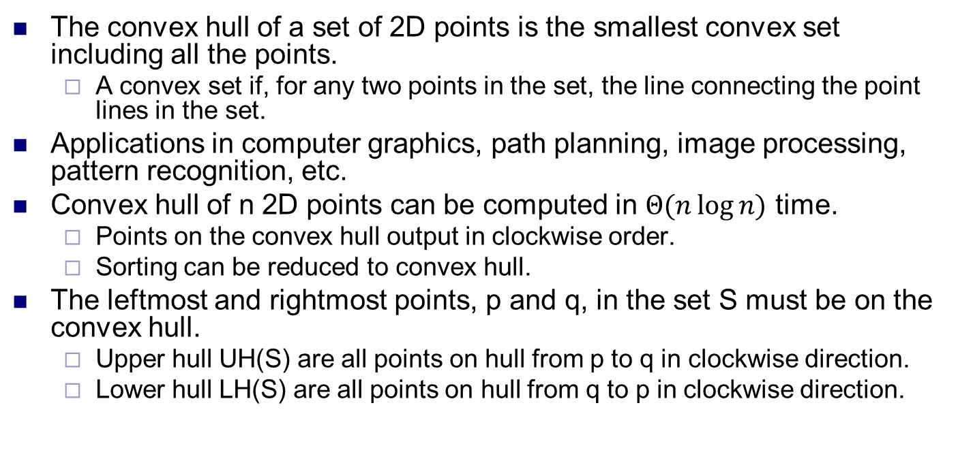
Convex hull
The convex hull of a set of 2D points is the smallest convex set including all the points.
A convex set if, for any two points in the set, the line connecting the point lines in the set.
Applications in computer graphics, path planning, image processing, pattern recognition, etc.
Convex hull of n 2D points can be computed in $Θ(n\log{n)}$ time.
Points on the convex hull output in clockwise order.
Sorting can be reduced to convex hull.
The leftmost and rightmost points, p and q, in the set S must be on the convex hull.
Upper hull UH(S) are all points on hull from p to q in clockwise direction.
Lower hull LH(S) are all points on hull from q to p in clockwise direction.

Slide 11
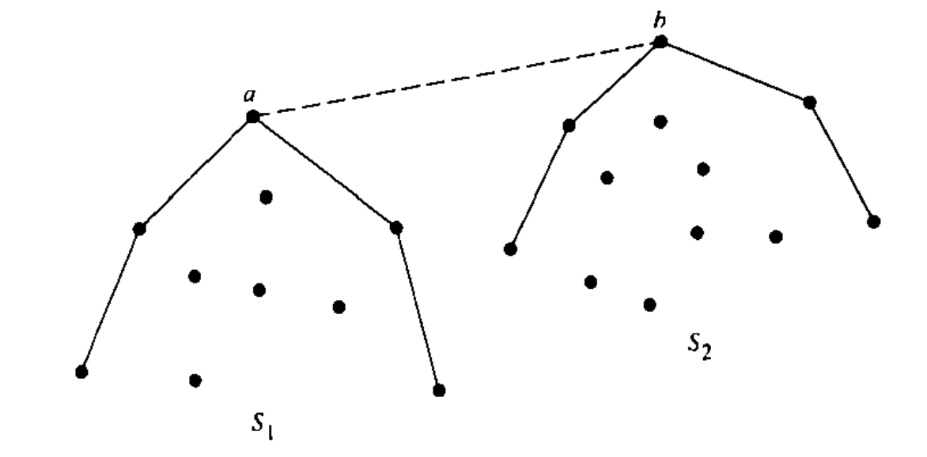
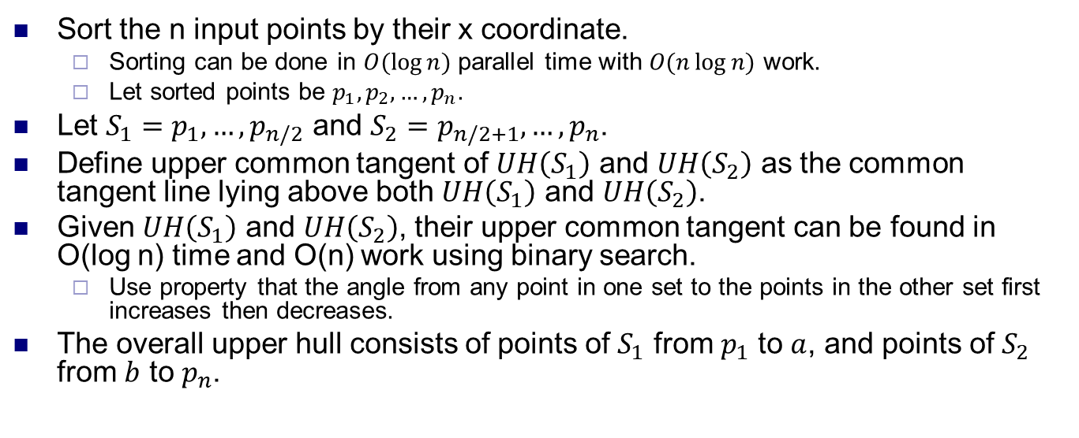
Divide and conquer
Sort the n input points by their x coordinate.
Sorting can be done in $O(\log{n)}$ parallel time with $O(n\log{n)}$ work.
Let sorted points be $p_{1},p_{2},…,p_{n}$.
Let $S_{1}=p_{1}, …, p_{n/2}$ and $S_{2}=p_{n/2+1},…, p_{n}$.
Define upper common tangent of $UH\left(S_{1}\right)$ and $UH\left(S_{2}\right)$ as the common tangent line lying above both $UH\left(S_{1}\right)$ and $UH\left(S_{2}\right)$.
Given $UH\left(S_{1}\right)$ and $UH\left(S_{2}\right)$, their upper common tangent can be found in O(log n) time and O(n) work using binary search.
Use property that the angle from any point in one set to the points in the other set first increases then decreases.
The overall upper hull consists of points of $S_{1}$ from $p_{1}$ to $a$, and points of $S_{2}$ from $b$ to $p_{n}$.

Slide 12
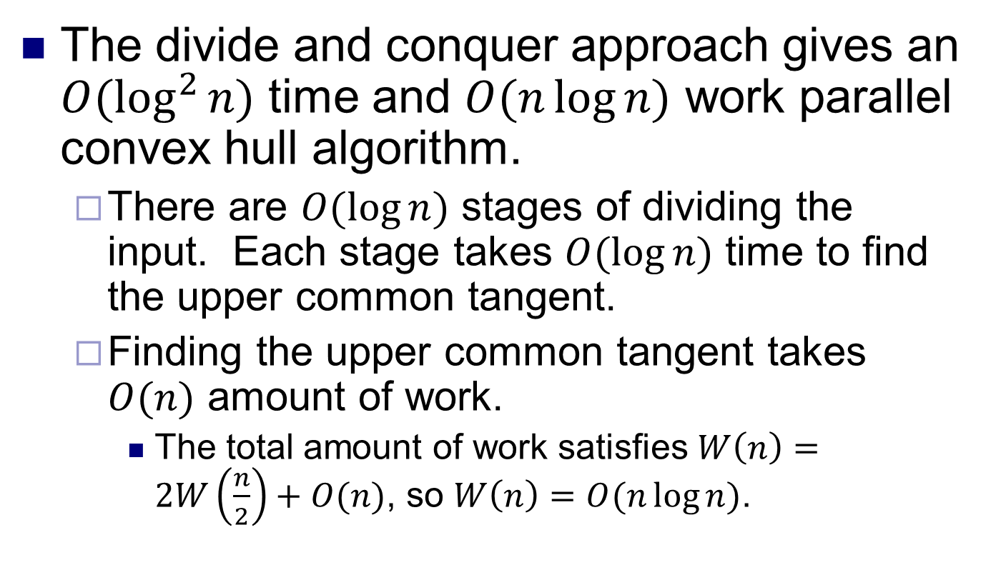
Parallel convex hull
The divide and conquer approach gives an $O(\log^{2}{n)}$ time and $O(n\log{n)}$ work parallel convex hull algorithm.
There are $O(\log{n)}$ stages of dividing the input. Each stage takes $O(\log{n)}$ time to find the upper common tangent.
Finding the upper common tangent takes $O(n)$ amount of work.
The total amount of work satisfies $W\left(n\right)=2W\left(\frac{n}{2}\right)+O(n)$, so $W\left(n\right)=O(n\log{n)}$.

Slide 13
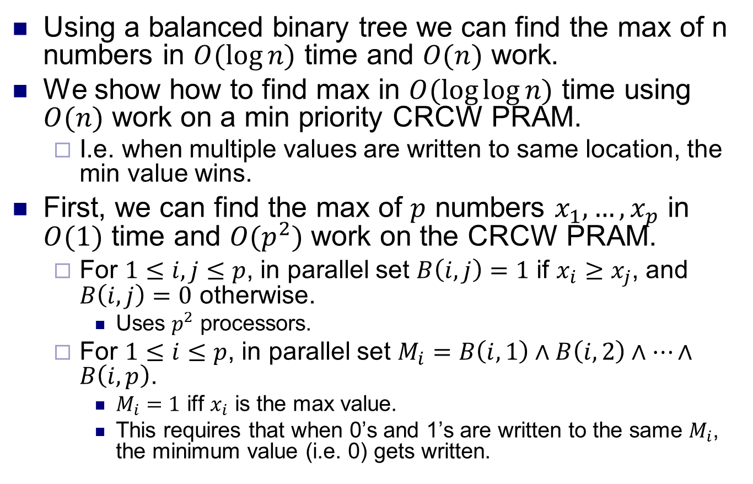
Constant time max finding
Using a balanced binary tree we can find the max of n numbers in $O(\log{n)}$ time and $O(n)$ work.
We show how to find max in $O(\log{\log{n)}}$ time using $O(n)$ work on a min priority CRCW PRAM.
I.e. when multiple values are written to same location, the min value wins.
First, we can find the max of $p$ numbers $x_{1},…,x_{p}$ in $O(1)$ time and $O(p^{2})$ work on the CRCW PRAM.
For $1≤i,j≤p$, in parallel set $B\left(i,j\right)=1$ if $x_{i}≥x_{j}$, and $B\left(i,j\right)=0$ otherwise.
Uses $p^{2}$ processors.
For $1≤i≤p$, in parallel set $M_{i}=B\left(i,1\right)∧B\left(i,2\right)∧…∧B\left(i,p\right)$.
$M_{i}=1$ iff $x_{i}$ is the max value.
This requires that when 0’s and 1’s are written to the same $M_{i}$, the minimum value (i.e. 0) gets written.

Slide 14
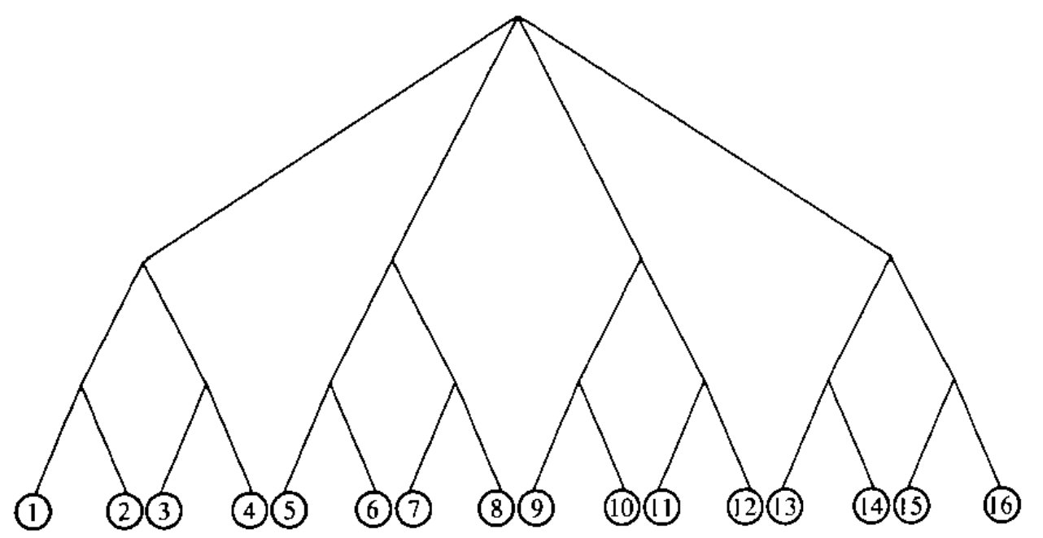
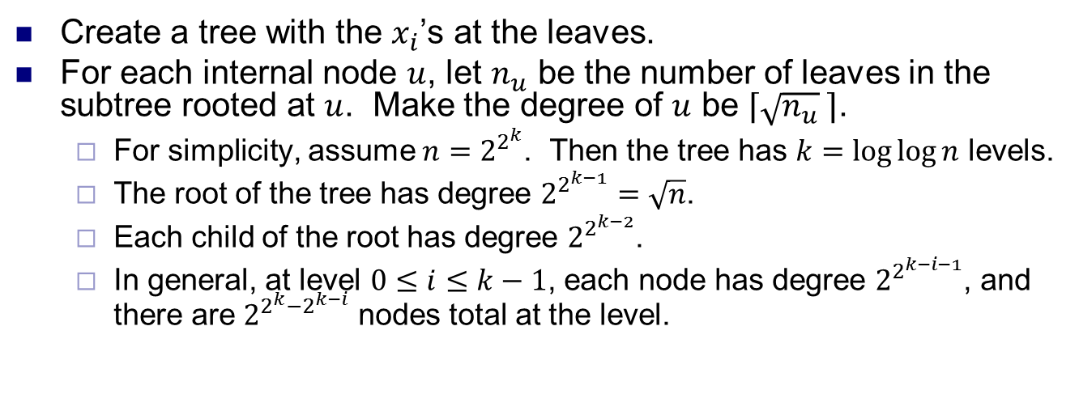
Doubly logarithmic tree
Create a tree with the $x_{i}$’s at the leaves.
For each internal node $u$, let $n_{u}$ be the number of leaves in the subtree rooted at $u$. Make the degree of $u$ be $⌈\sqrt{n_{u}} ⌉$.
For simplicity, assume $n=2^{2^{k}}$. Then the tree has $k=\log{\log{n}}$ levels.
The root of the tree has degree $2^{2^{k−1}}=\sqrt{n}$.
Each child of the root has degree $2^{2^{k−2}}$.
In general, at level $0≤i≤k−1$, each node has degree $2^{2^{k−i−1}}$, and there are $2^{2^{k}−2^{k−i}}$ nodes total at the level.
Source: Introduction to Parallel Algorithms, Jaja

Slide 15
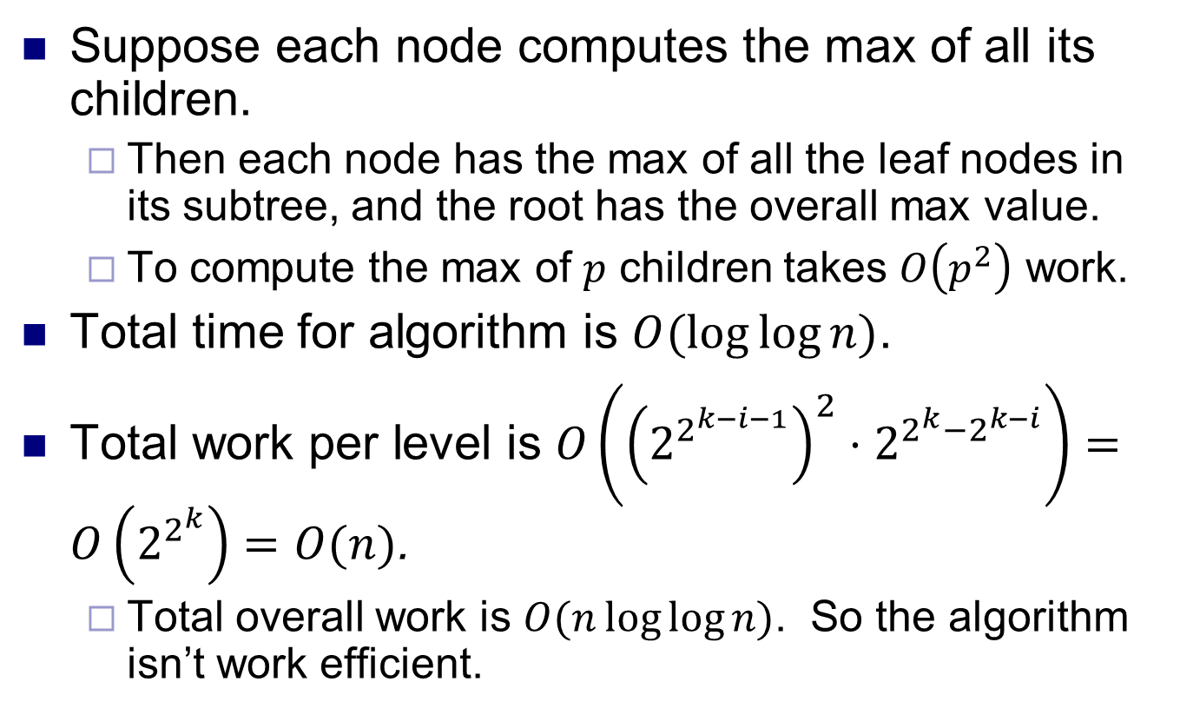
Superfast max finding
Suppose each node computes the max of all its children.
Then each node has the max of all the leaf nodes in its subtree, and the root has the overall max value.
To compute the max of $p$ children takes $O\left(p^{2}\right)$ work.
Total time for algorithm is $O(\log{\log{n)}}$.
Total work per level is $O\left({\left(2^{2^{k−i−1}}\right)}^{2}⋅2^{2^{k}−2^{k−i}}\right)=O\left(2^{2^{k}}\right)=O(n)$.
Total overall work is $O(n\log{\log{n)}}$. So the algorithm isn’t work efficient.

Slide 16
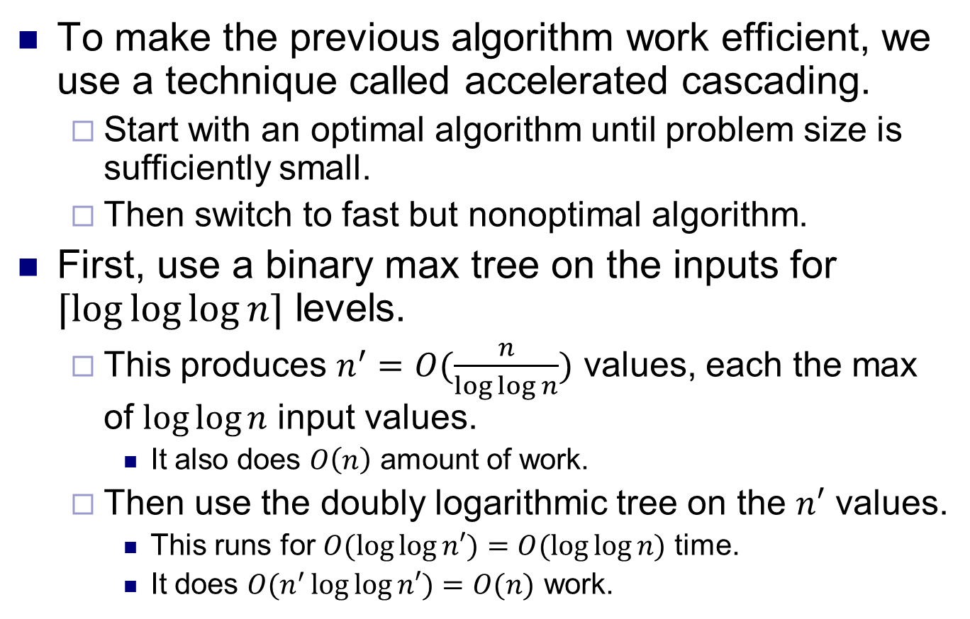
Superfast max finding
To make the previous algorithm work efficient, we use a technique called accelerated cascading.
Start with an optimal algorithm until problem size is sufficiently small.
Then switch to fast but nonoptimal algorithm.
First, use a binary max tree on the inputs for $⌈\log{\log{\log{n⌉}}}$ levels.
This produces $n^{′}=O(\frac{n}{\log{\log{n}}})$ values, each the max of $\log{\log{n}}$ input values.
It also does $O\left(n\right)$ amount of work.
Then use the doubly logarithmic tree on the $n′$ values.
This runs for $O(\log{\log{n′)}=O(\log{\log{n)}}}$ time.
It does $O(n^{′}\log{\log{n′)=O(n)}}$ work.

Slide 17
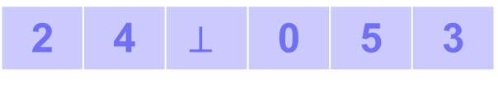
List ranking
Given a linked list, compute the distance of each node to the end.
Linked list is represented by an array next, where next[i] initially points to node following node i.
next[i]=NULL for the last node.
Let d[i] be i’s estimate of its distance to the end.
Initially d[i]=0 for the last node, and d[i]=1 for all other nodes.
i
0
1
2
3
4
5
next[i]
2 | 4 | $$⊥$$ | 0 | 5 | 3
i
1
4
5
3
0
2
d[i]
5
4
3
2
1
0

Slide 18
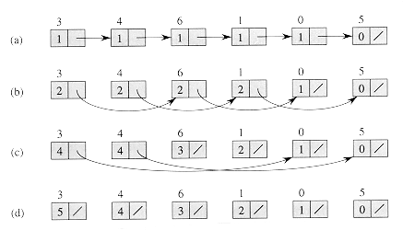
List ranking
Repeatedly apply pointer jumping.
If currently i→j and j→k, set i→k.
Let k be a node that’s distance m away from the end, for some m.
After i steps, d[k]=min(m,2^{i}), and next[k] points min(m,2^{i}) distance away.
Since d[*] ≤ n, algorithm terminates in O(log n) steps.
Work is O(n log n).
Not efficient, since sequential list ranking takes O(n) work.
List randking has many applications, including Euler tour technique, connected components, expression tree evaluation, ear decomposition, etc.
while next[i]≠NULL for some i
do parallel for all i
if next[i]≠NULL
d[i]=d[i]+d[next[i]]
next[i]=next[next[i]]

Slide 19
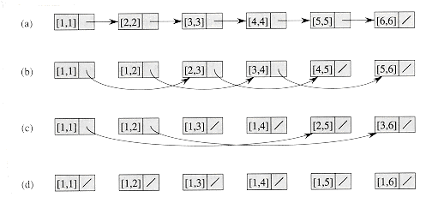
Prefix sum on linked list
We’ve seen how to do prefix sum on an array.
Using pointer jumping, can also do prefix sum on a linked list.
Initially each node i has a value x[i].
The output, i.e. prefix sum of node i is stored in d[i].
Only difference with list ranking is update d[next[i]] instead of d[i].
After i steps, first 2^{i} nodes have correct prefix sum, and other nodes have the sum of the preceding 2^{i} values.
Takes O(log n) time, does O(n log n) work.
do parallel for all i
d[i]=x[i]
while next[i]≠NULL for some i
do parallel for all i
if next[i]≠NULL
d[next[i]]=d[i]+d[next[i]]
next[i]=next[next[i]]

Slide 20
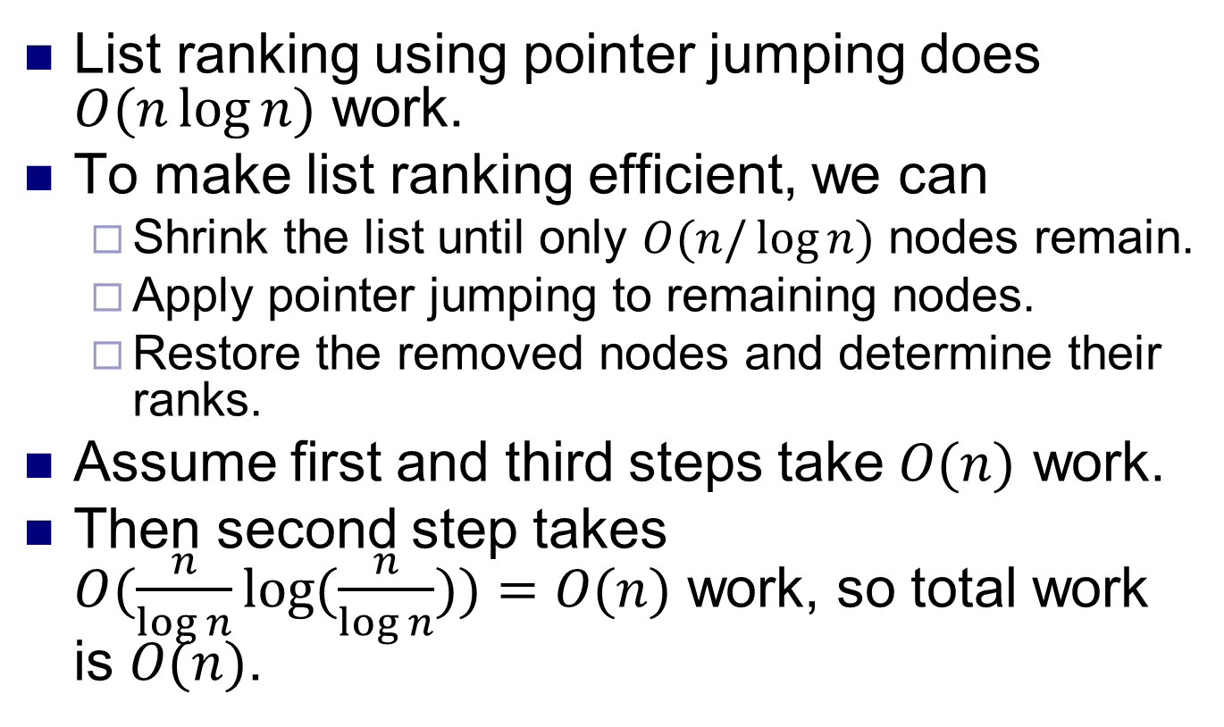
Work efficient list ranking
List ranking using pointer jumping does $O(n\log{n)}$ work.
To make list ranking efficient, we can
Shrink the list until only $O(n/\log{n)}$ nodes remain.
Apply pointer jumping to remaining nodes.
Restore the removed nodes and determine their ranks.
Assume first and third steps take $O(n)$ work.
Then second step takes $O(\frac{n}{\log{n}}\log{(\frac{n}{\log{n}}))=O(n)}$ work, so total work is $O(n)$.

Slide 21
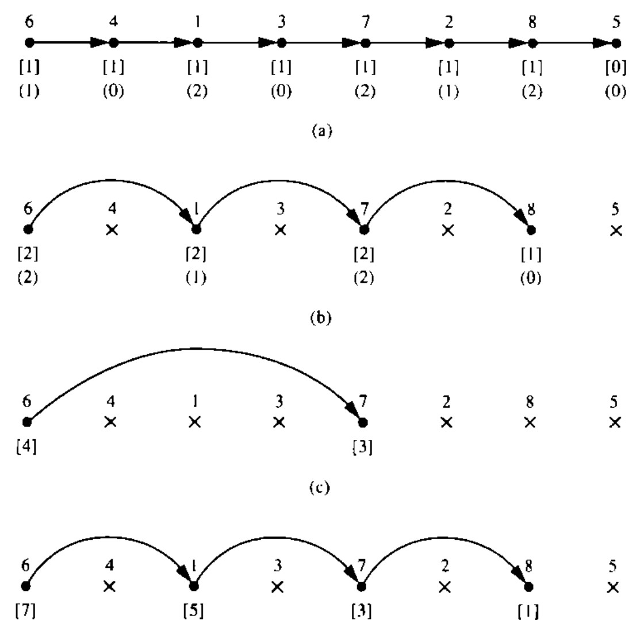
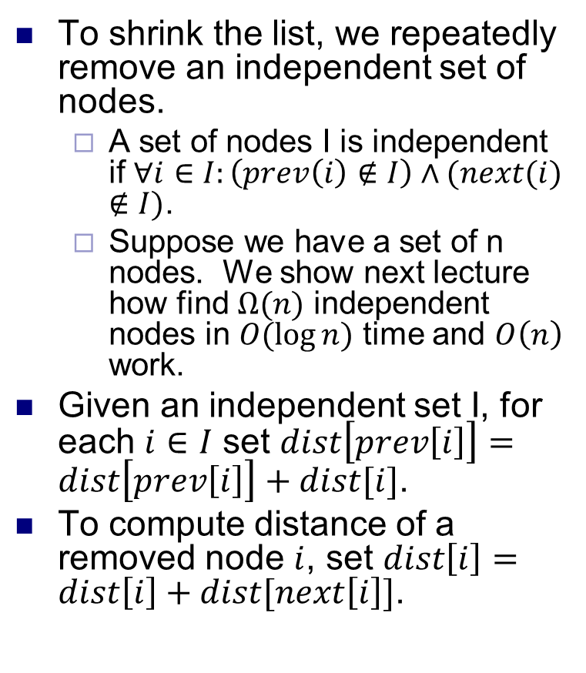
Work efficient list ranking
To shrink the list, we repeatedly remove an independent set of nodes.
A set of nodes I is independent if $∀i∈I:\left(prev\left(i\right)∉I\right)∧(next(i)$ $∉I)$.
Suppose we have a set of n nodes. We show next lecture how find $Ω(n)$ independent nodes in $O(\log{n)}$ time and $O\left(n\right)$ work.
Given an independent set I, for each $i∈I$ set $dist\left[prev\left[i\right]\right]=dist\left[prev\left[i\right]\right]+dist[i]$.
To compute distance of a removed node $i$, set $dist\left[i\right]=dist\left[i\right]+dist[next\left[i\right]]$.
values in parentheses are used to find independent set.
dist values are shown in brackets.

Slide 22
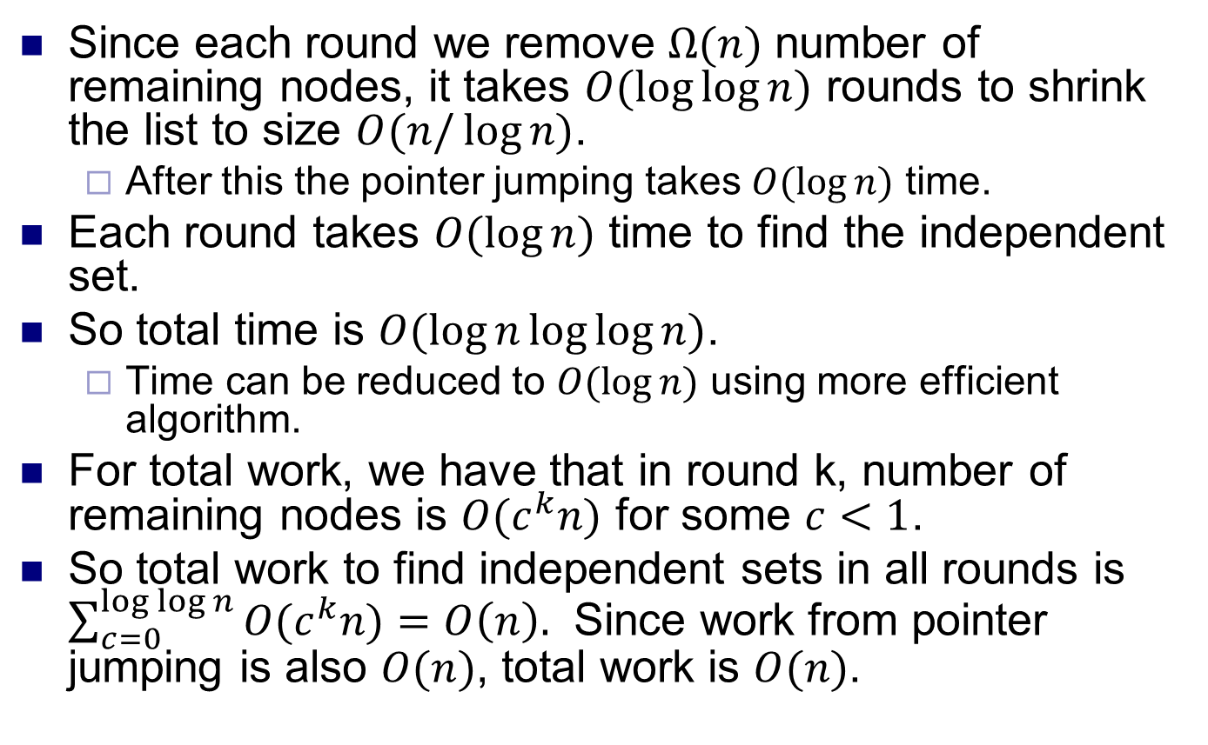
Work efficient list ranking
Since each round we remove $Ω(n)$ number of remaining nodes, it takes $O(\log{\log{n)}}$ rounds to shrink the list to size $O(n/\log{n)}$.
After this the pointer jumping takes $O(\log{n)}$ time.
Each round takes $O(\log{n)}$ time to find the independent set.
So total time is $O(\log{n\log{\log{n)}}}$.
Time can be reduced to $O(\log{n)}$ using more efficient algorithm.
For total work, we have that in round k, number of remaining nodes is $O(c^{k}n)$ for some $c<1$.
So total work to find independent sets in all rounds is $\sum_{c=0}^{\log{\log{n}}}{{O(c}^{k}n)}=O\left(n\right).$ Since work from pointer jumping is also $O(n)$, total work is $O(n)$.

